Slide 1
Bitcoin Price Prediction and Analysis Using Deep Learning Models
S.NARTHANA – 21MIA1124 Sammeta Lekhana – 21MIA1080 Dillibabu.G-21MIA1148

Slide 2

Outline
Recurrent neural network (RNN)
Long Short-Term Memory (LSTM)
LSTM Model Implementation:
Gated Recurrent Unit (GRU)
GRU Model Implementation
Comparison of compilation time required by both the deep learning-based models
Comparison of actual and predicted bitcoin price
Bitcoin price prediction for both LSTM AND GRU – 7 days ahead

Slide 3
Recurrent neural network (RNN)
A recurrent neural network (RNN) is a type of artificial neural network that is designed to process sequential data by utilizing feedback connections.
RNNs are capable of capturing dependencies and patterns in sequential data by maintaining a memory state that allows them to incorporate information from previous inputs while processing current inputs.
Two common RNN networks are LSTM and GRU and presented in the subsequent sections.

Slide 4
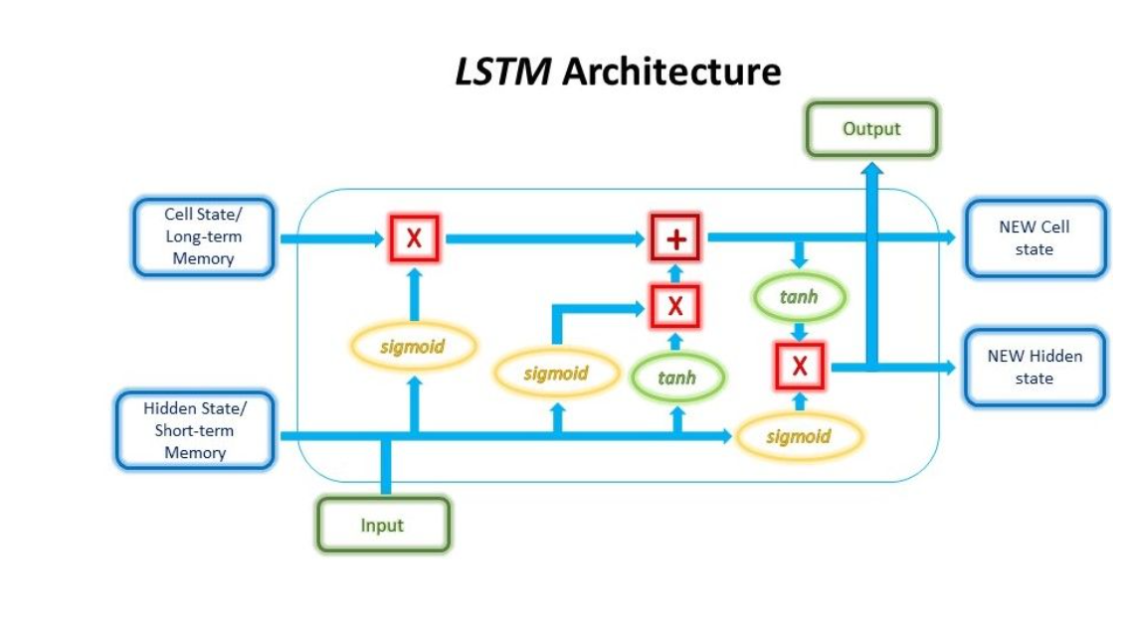
Long Short-Term Memory (LSTM)
Long Short-Term Memory (LSTM) is a variant of recurrent neural networks (RNNs) that addresses the vanishing gradient problem and enables better capturing of long-term dependencies in sequential data.
LSTMs have a more complex structure with memory cells, input gates, forget gates, and output gates. The memory cells store and propagate information over time, while the gates regulate the flow of information.
The forget gate determines what information to discard, the input gate decides what new information to incorporate, and the output gate controls what information to output.
This architecture allows LSTMs to effectively model and remember important patterns in sequential data.

Slide 5
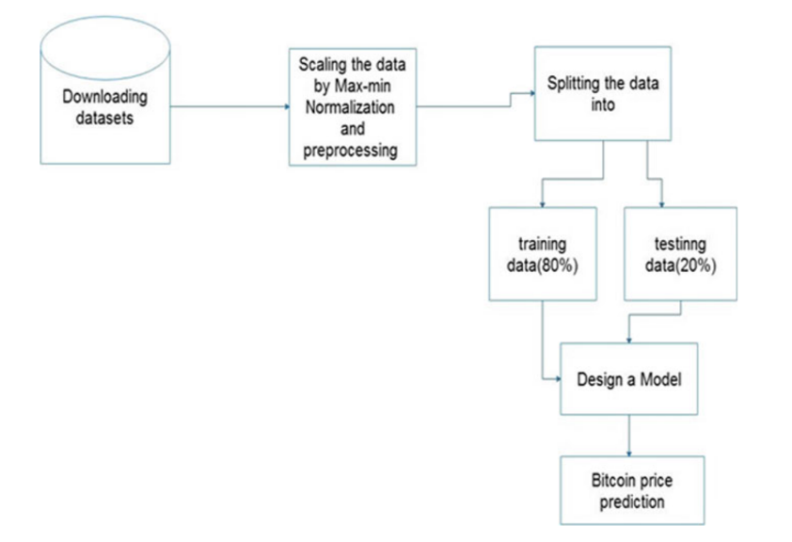
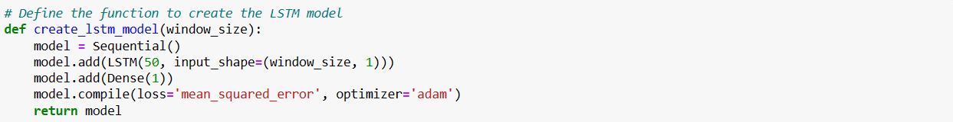
LSTM Model Implementation:

Slide 6
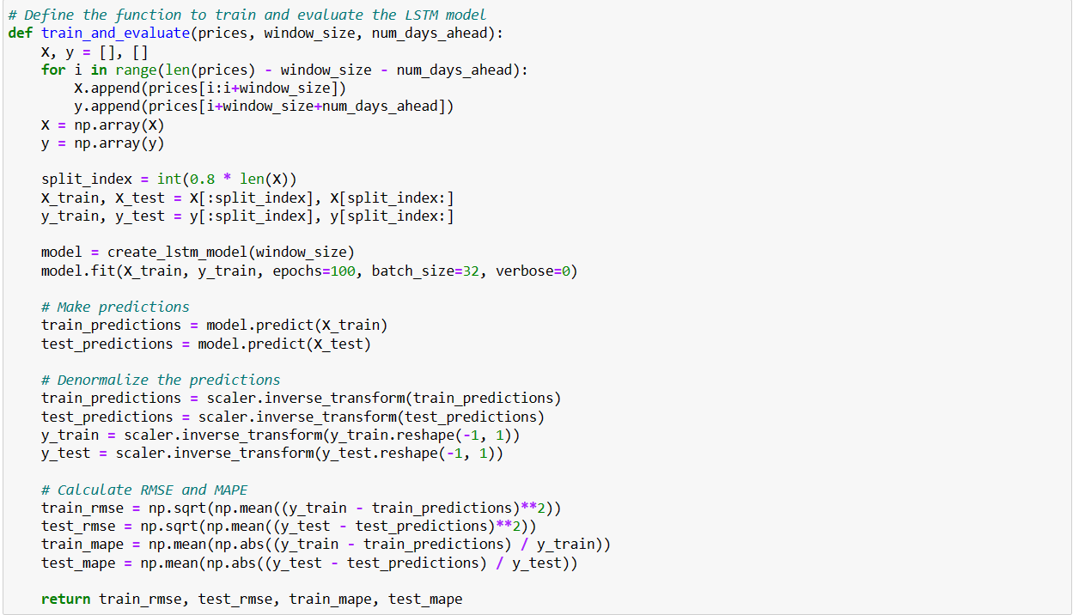

Slide 7
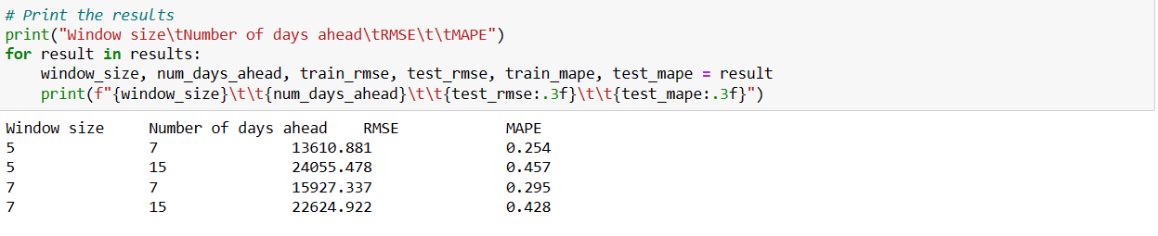

Slide 8
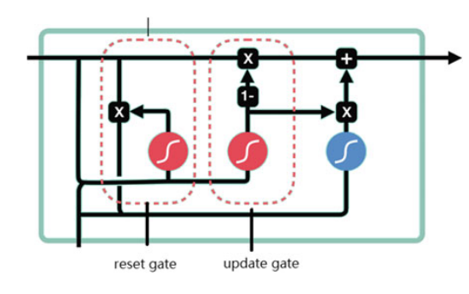
Gated Recurrent Unit (GRU)
The GRU is the newer generation of recurrent neural networks and is pretty similar to an LSTM. GRU got rid of the cell state and used the hidden state to transfer information. It has also only two gates, a reset gate and update gate as shown in Fig.
Reset Gate: The reset gate is another gate that is used to decide how much past information to forget.
Update Gate: The update gate acts similar to the forget and input gate of an LSTM. It decides what information to throw away and what new information to be added

Slide 9
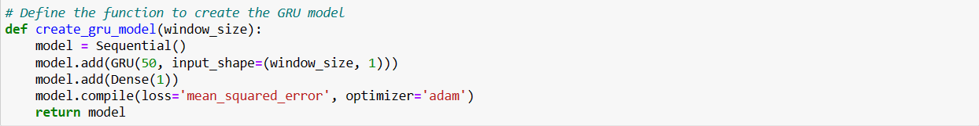
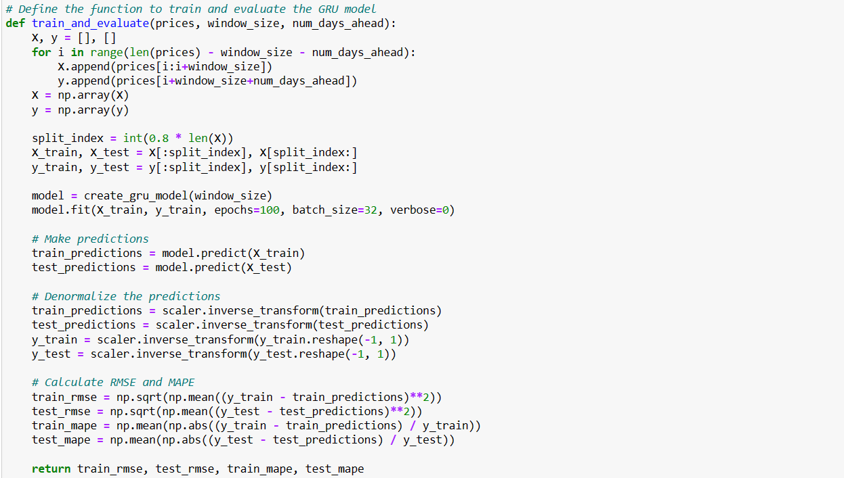
GRU Model Implementation

Slide 10
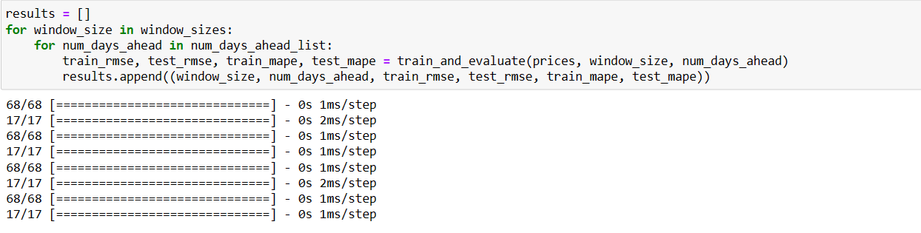
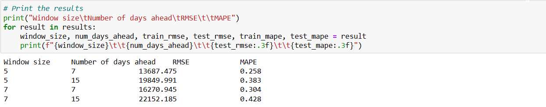

Slide 11
One of the common ways to compare the time series models is to measure their performance for short- and long-term prediction. To validate the performance of these two models, we have used MAPE (Mean Absolute Percentage Error) and RMSE (Root Mean Square Error) as performance measure
Window size | Number of days ahead | LSTM RMSE | LSTM MAPE | GRU RMSE | GRU MAPE
5 | 7 | 13610.881 | 0.254 | 13687.475 | 0.258
5 | 15 | 24055.478 | 0.457 | 19849.991 | 0.383
7 | 7 | 15927.337 | 0.295 | 16270.945 | 0.304
7 | 15 | 22624.922 | 0.428 | 22152.185 | 0.428
Since their performance varies depending on the window size and number of days ahead. The LSTM model performs better for window size 5 and 7 days ahead, while the GRU model performs better for window size 5 and 15 days ahead. For window size 7 and 7 days ahead, the LSTM model performs slightly better, while for window size 7 and 15 days ahead, both models have similar performance.
In summary, if you prioritize lower RMSE and MAPE, you may prefer the LSTM model for window size 5 and 7 days ahead, and window size 7 and 7 days ahead. If you prioritize lower RMSE, the GRU model may be preferred for window size 5 and 15 days ahead

Slide 12
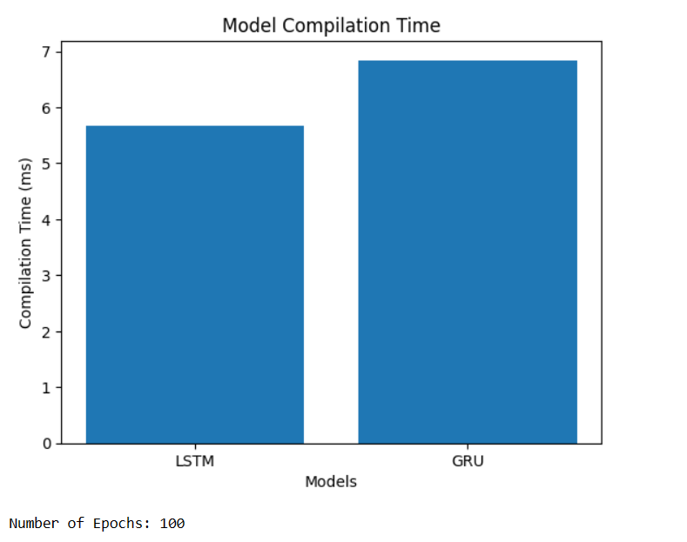

Comparison of compilation time required by both the deep learning-based models

Slide 13
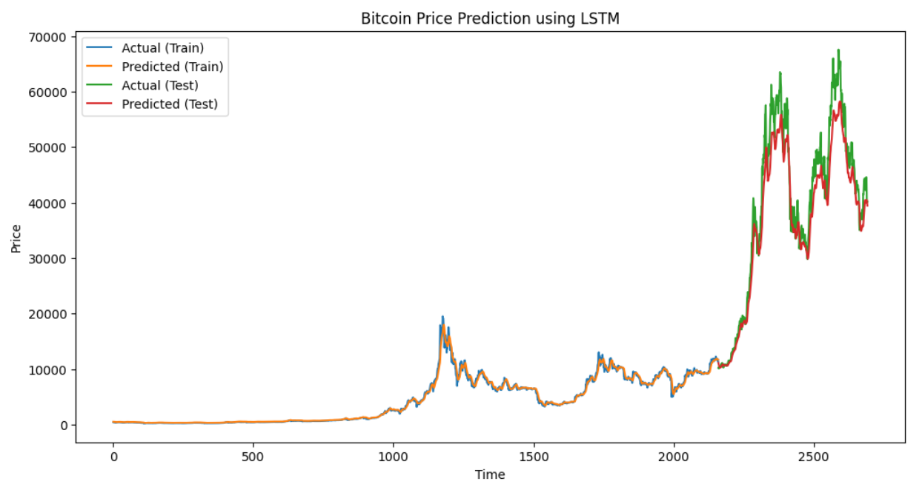
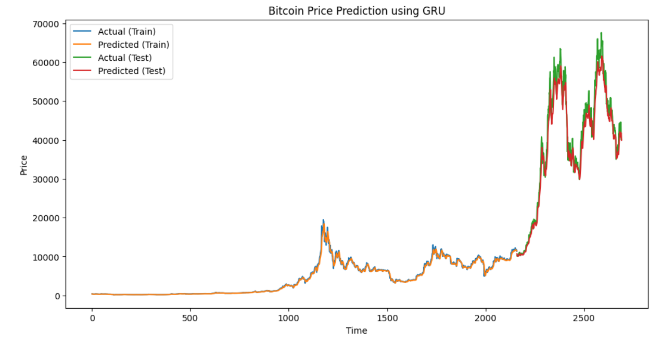
Comparison of actual and predicted bitcoin price

Slide 14
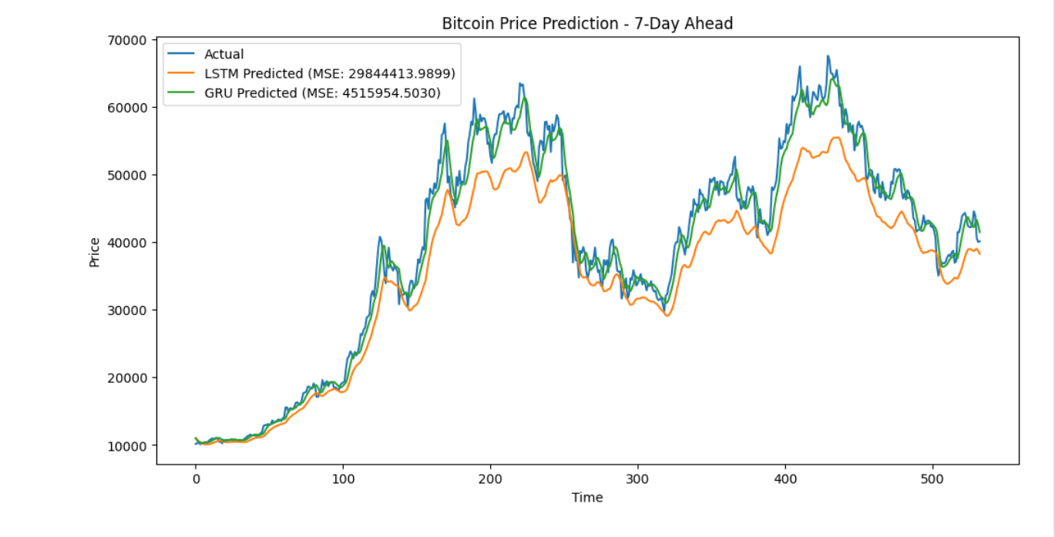
Bitcoin price prediction for both LSTM AND GRU – 7 days ahead
Based on the provided mean squared error (MSE) values, the LSTM model has an MSE of 29,844,413.9899, while the GRU model has a lower MSE of 4,515,954.5030.
Since the goal is to minimize the MSE, the GRU model with a lower MSE of 4,515,954.5030 is considered better in this case. It indicates that the GRU model's predictions have a lower average squared difference from the actual values compared to the LSTM model.
Therefore, if the main evaluation criterion is the MSE, the GRU model outperforms the LSTM model.

